Slide 1
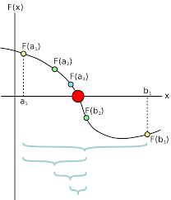
Root Finding
Numerical Analysis

Slide 2
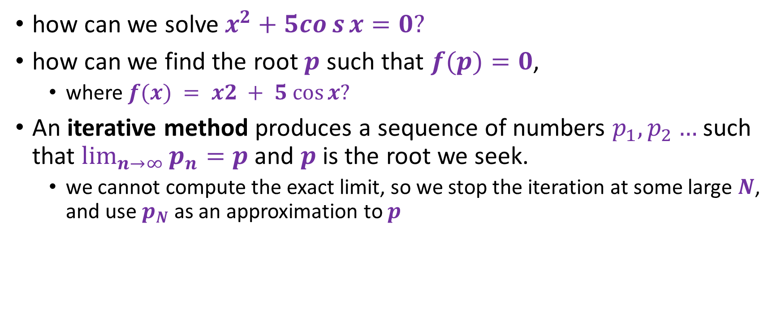
The general problem
how can we solve $x^{2}+5cos{x}=0?$
how can we find the root $p$ such that $f(p)=0$,
where $f(x) = x2 + 5 cos⁡x?$
An iterative method produces a sequence of numbers $p_{1}, p_{2}…$such that $\lim_{n→∞}{p_{n}=p }$and $p$is the root we seek.
we cannot compute the exact limit, so we stop the iteration at some large $N$, and use $p_{N}$ as an approximation to $p$

Slide 3
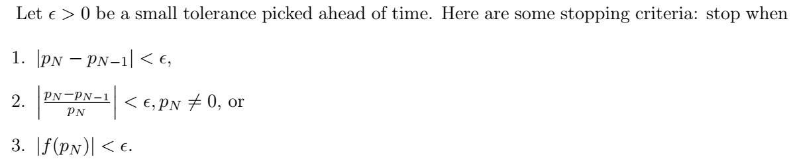
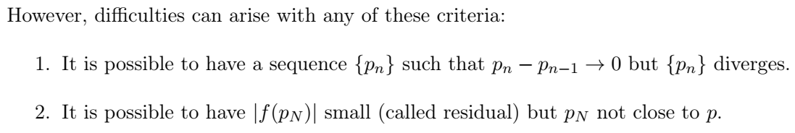
The Stopping Criteria

Slide 4
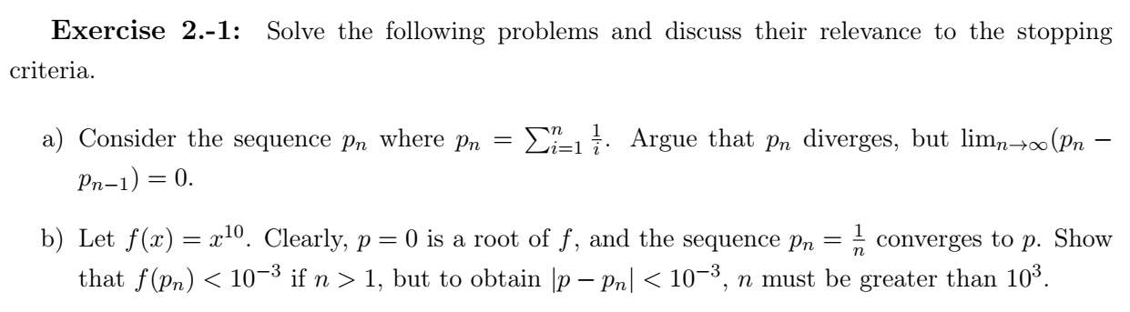
Example

Slide 5
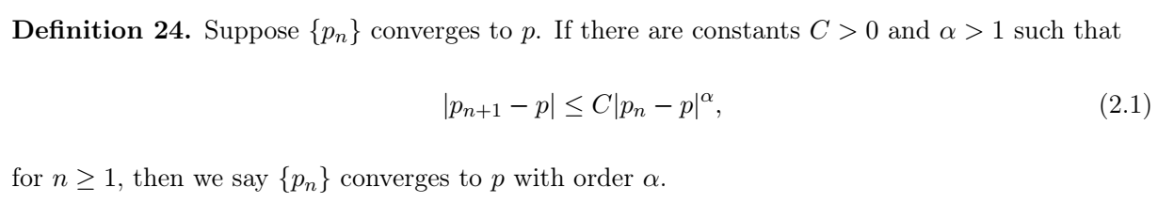

Error analysis for iterative methods
Assume we have an iterative method $f(n)$ that converges to the root $p$ of some function.
How can we assess the rate of convergence?

Slide 6
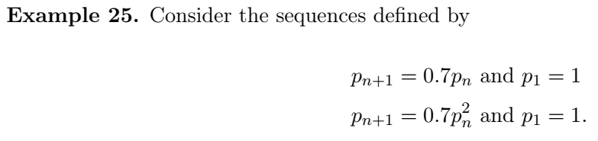
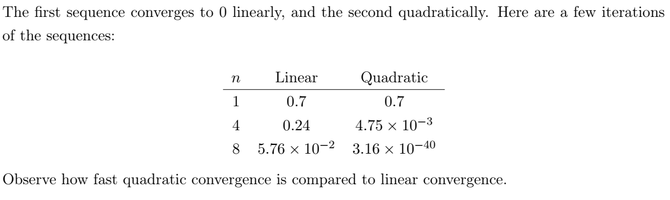
Convergence Example

Slide 7
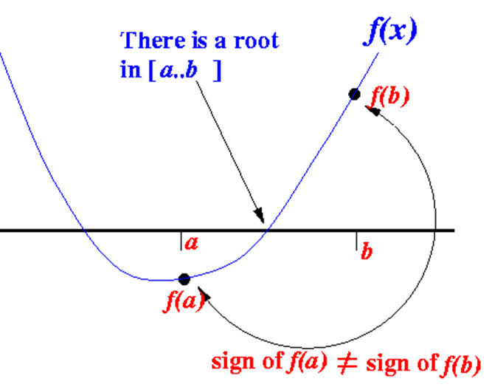
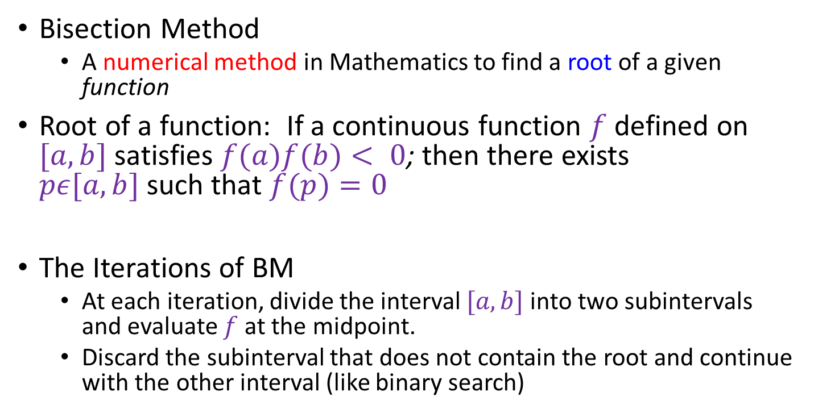
Bisection method (BM)
Bisection Method
A numerical method in Mathematics to find a root of a given function
Root of a function: If a continuous function $f$ defined on $[a, b]$ satisfies $f(a)f(b)< 0$; then there exists $pε[a, b]$such that $f(p)=0$
The Iterations of BM
At each iteration, divide the interval $[a,b]$into two subintervals and evaluate $f$ at the midpoint.
Discard the subinterval that does not contain the root and continue with the other interval (like binary search)
f(p) = 0

Slide 8
Roots Example
Function: f(x) = x² - 4
Roots: x = -2, x = 2
Because:
f(-2) = (-2)² - 4 = 4 - 4 = 0
f(2) = (2)² - 4 = 4 - 4 = 0

Slide 9
The Bisection Method
The Bisection Method is a successive approximation method that narrows down an interval that contains a root of the function f(x)
The Bisection Method is given an initial interval [a..b] that contains a root (We can use the property sign of f(a) ≠ sign of f(b) to find such an initial interval)
The Bisection Method will cut the interval into 2 halves and check which half interval contains a root of the function
The Bisection Method will keep cut the interval in halves until the resulting interval is extremely small
The root is then approximately equal to any value in the final (very small) interval.

Slide 10
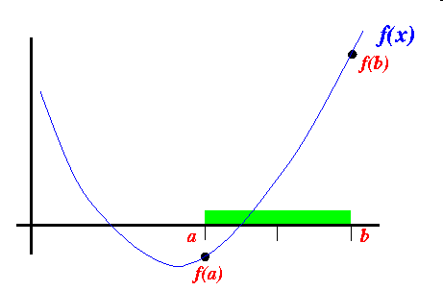
The Bisection Method (cont.)
Suppose the interval [a..b] is as follows:

Slide 11
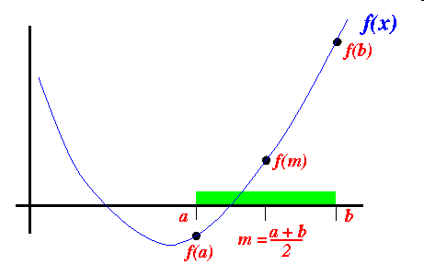

The Bisection Method (cont.)
We cut the interval $[a..b]$in the middle: $m =\frac{a+b}{2}$

Slide 12
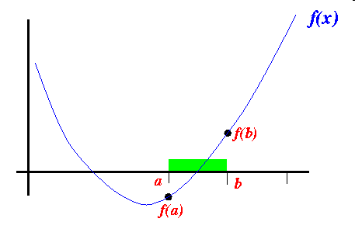
The Bisection Method (cont.)
Because sign of $f(m) ≠ sign of f(a)$, we proceed with the search in the new interval $[a..b]:$

Slide 13
The Bisection Method (cont.)
We can use this statement to change to the new interval:
b = m;

Slide 14
The Bisection Method (cont.)
In the above example, we have changed the end point b to obtain a smaller interval that still contains a root
In other cases, we may need to changed the end point b to obtain a smaller interval that still contains a root

Slide 15
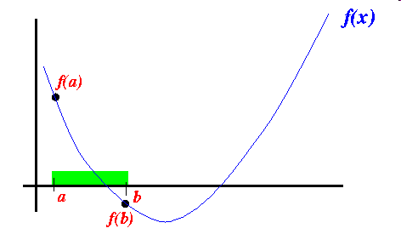
The Bisection Method (cont.)
Here is an example where you have to change the end point a:
Initial interval [a..b]:

Slide 16
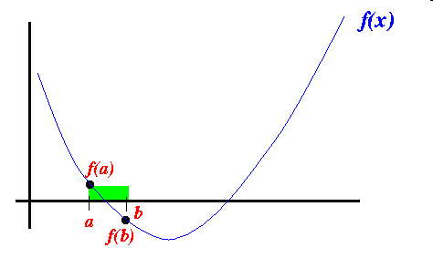
The Bisection Method (cont.)
After cutting the interval in half, the root is contained in the right-half, so we have to change the end point a:

Slide 17
The Bisection Method (cont.)
Rough description (pseudo code) of the Bisection Method:
Given: interval [a..b] such that: sign of f(a) ≠ sign of f(b)
repeat (until the interval [a..b] is "very small")
{
a+b
m = -----; // m = midpoint of interval [a..b]
2
if ( sign of f(m) ≠ sign of f(b) )
{
use interval [m..b] in the next iteration

Slide 18
The Bisection Method (cont.)
(i.e.: replace a with m)
}
else
{
use interval [a..m] in the next iteration
(i.e.: replace b with m)
}
}
Approximate root = (a+b)/2; (any point between [a..b] will do
because the interval [a..b] is very small)

Slide 19
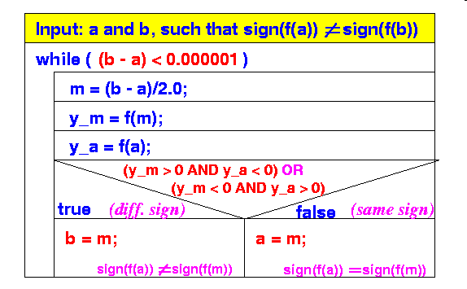
The Bisection Method (cont.)
Structure Diagram of the Bisection Algorithm:

Slide 20
The Bisection Method (cont.)
Example execution:
We will use a simple function to illustrate the execution of the Bisection Method
Function used:
Roots: √3 = 1.7320508... and −√3 = −1.7320508...
f(x) = x² - 3

Slide 21
The Bisection Method (cont.)
We will use the starting interval [0..4] since:
The interval [0..4] contains a root because: sign of f(0) ≠ sign of f(4)
f(0) = 0² − 3 = −3
f(4) = 4² − 3 = 13

Slide 22
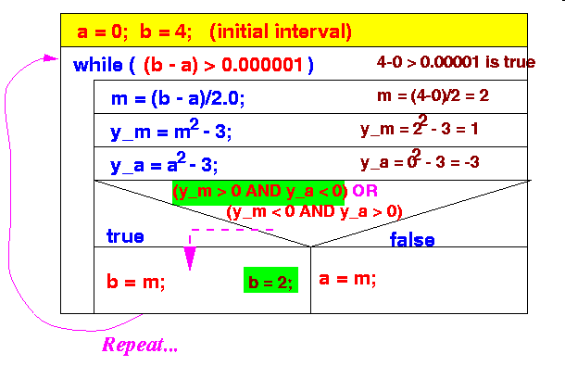
The Bisection Method (cont.)
Steps taken by the Bisection Method:
Iteration 1:
New interval: [0..2] (it contains √3 = 1.7320508.. !!!)

Slide 23
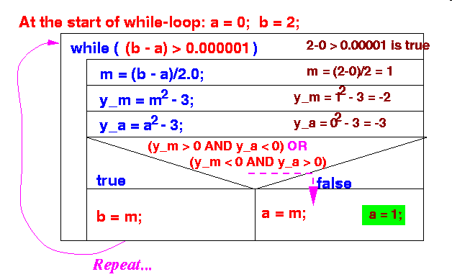
The Bisection Method (cont.)
Iteration 2:
New interval: [1..2] (it contains √3 = 1.7320508.. !!!)

Slide 24
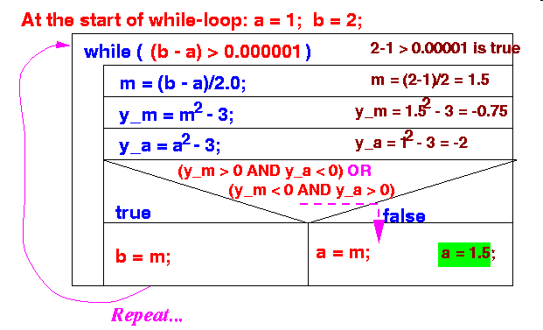
The Bisection Method (cont.)
Iteration 3:
New interval: [1.5 .. 2] (it contains √3 = 1.7320508.. !!!)

Slide 25
The Bisection Method (cont.)
And so on
Result:
The interval gets smaller and smaller
But it will always contain the root √3
When the interval is smaller than 0.000001, the while-loop will exit
At that moment, the end points of the interval will be very close to root √3

Slide 26
The Bisection Method (cont.)
Java program:
// Bisection Method - Solves: x^2 - 3 = 0
public class Bisection01
{
public static void main(String[] args)
{
final double epsilon = 0.00001;
double a, b, m, y_m, y_a;
a = 0; b = 4;
while ( (b-a) > epsilon )
{
m = (a+b)/2; // Mid point

Slide 27
The Bisection Method (cont.)
y_m = m*m - 3.0; // y_m = f(m)
y_a = a*a - 3.0; // y_a = f(a)
if ( (y_m > 0 && y_a < 0) || (y_m < 0 && y_a > 0) )
{ // f(a) and f(m) have different signs: move b
b = m;
}
else
{ // f(a) and f(m) have same signs: move a
a = m;
}
System.out.println("New interval: [" + a + " .. " + b + "]");
// Print progress
}
System.out.println("Approximate solution = " + (a+b)/2 );
}
}

Slide 28
The Bisection Method (cont.)
Output:
Initial interval: [0.0 .. 4.0]
New interval: [0.0 .. 2.0](We did the first 3 by hand above)
New interval: [1.0 .. 2.0]
New interval: [1.5 .. 2.0]
New interval: [1.5 .. 1.75]
New interval: [1.625 .. 1.75]
New interval: [1.6875 .. 1.75]
New interval: [1.71875 .. 1.75]
New interval: [1.71875 .. 1.734375]
New interval: [1.7265625 .. 1.734375]
New interval: [1.73046875 .. 1.734375]
New interval: [1.73046875 .. 1.732421875]
New interval: [1.7314453125 .. 1.732421875]
New interval: [1.73193359375 .. 1.732421875]
New interval: [1.73193359375 .. 1.732177734375]
New interval: [1.73193359375 .. 1.7320556640625]
New interval: [1.73199462890625 .. 1.7320556640625]
New interval: [1.732025146484375 .. 1.7320556640625]
New interval: [1.7320404052734375 .. 1.7320556640625]
New interval: [1.7320480346679688 .. 1.7320556640625]
Approximate solution = 1.7320518493652344

Slide 29
The Bisection Method (cont.)
Example Program: (Demo above code)
Prog file: http://mathcs.emory.edu/~cheung/Courses/170/Syllabus/07/Progs/Bisection01.java
How to run the program:
Right click on link and save in a scratch directory
To compile: javac Bisection01.java
To run: java Bisection01

Slide 30
Finding the roots of a different function
Suppose we want to find the root of
in the interval [0..4]
f(x) = x³ + x - 3

Slide 31
Finding the roots of a different function (cont.)
Changes to the Java program:
// Solves: x^3 + x - 3 = 0
public class Bisection02
{
public static void main(String[] args)
{
final double epsilon = 0.00001;
double a, b, m, y_m, y_a;
a = 0; b = 4;
while ( (b-a) > epsilon )
{
m = (a+b)/2; // Mid point

Slide 32
Finding the roots of a different function (cont.)
y_m = m*m*m + m - 3.0; // y_m = f(m)
y_a = a*a*a + a - 3.0; // y_a = f(a)
if ( (y_m > 0 && y_a < 0) || (y_m < 0 && y_a > 0) )
{ // f(a) and f(m) have different signs: move b
b = m;
}
else
{ // f(a) and f(m) have same signs: move a
a = m;
}
System.out.println("New interval: [" + a + " .. " + b + "]");
}
System.out.println("Approximate solution = " + (a+b)/2 );
}
}

Slide 33
Finding the roots of a different function (cont.)
Example Program: (Demo above code)
Prog file: http://mathcs.emory.edu/~cheung/Courses/170/Syllabus/07/Progs/Bisection02.java
How to run the program:
Right click on link and save in a scratch directory
To compile: javac Bisection02.java
To run: java Bisection02

Slide 34
Finding the roots of a different function (cont.)
We had to change the body of the Java program to find the root of a different function
This is very inconvenient
It would be more convenient to if we can write:
y_m = f(m);
y_a = f(a);

Slide 35
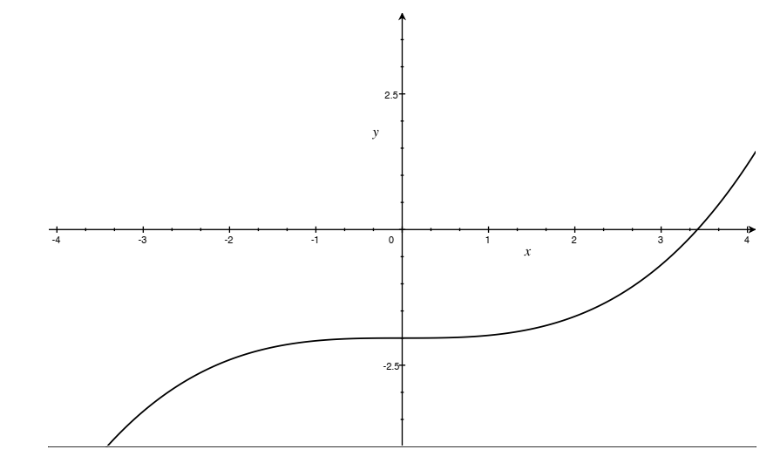
Example
Compute the first three iterations by hand for the function plotted

Slide 36
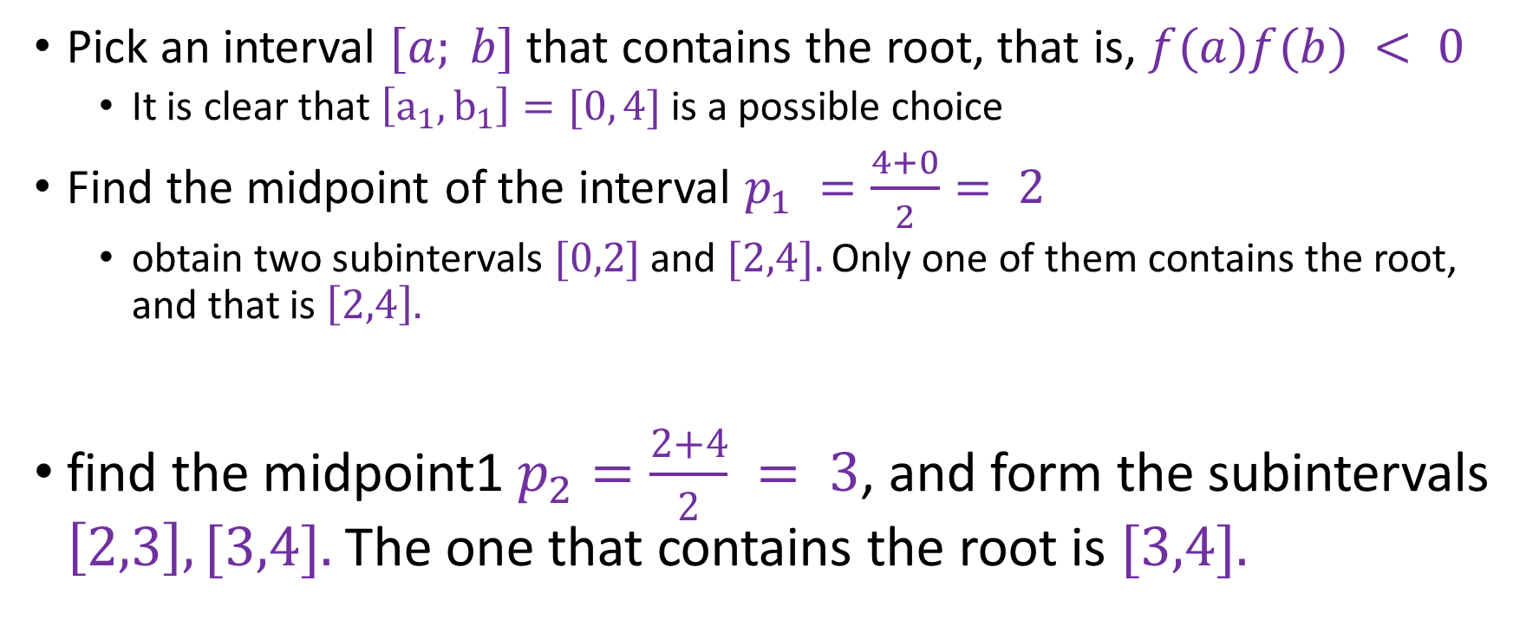
Step 1
Pick an interval $[a; b]$that contains the root, that is, $f(a)f(b) < 0$
It is clear that $\left[a_{1},b_{1}\right]=[0, 4]$is a possible choice
Find the midpoint of the interval $p_{1} =\frac{4+0}{2}= 2$
obtain two subintervals $[0,2]$and $[2,4].$Only one of them contains the root, and that is $\left[2,4\right].$
find the midpoint1 $p_{2}=\frac{2+4}{2} = 3$, and form the subintervals $\left[2,3\right], [3,4].$The one that contains the root is $[3,4].$
Step 2

Slide 37

Step 3
We have $[a_{3}, b_{3}]=[3,4].$The midpoint is $p_{3}=3.5$. We are now pretty close to the root visually, and we stop the calculations!
Example

Slide 38
Python code
import numpy as np

Slide 39
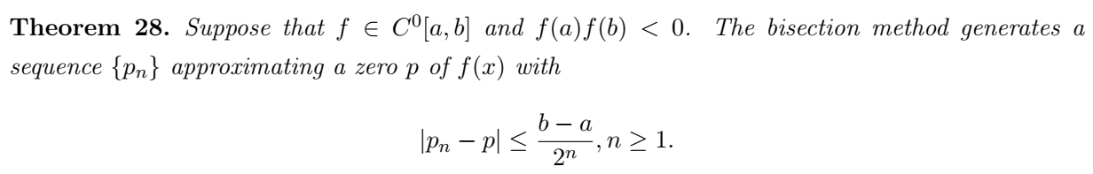
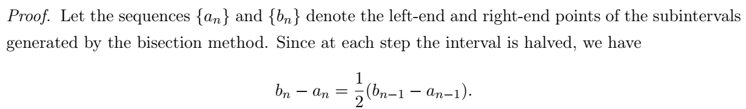
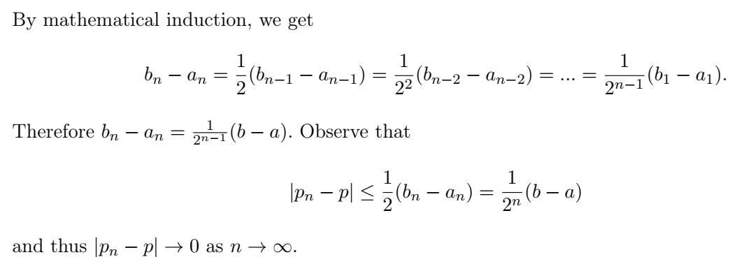
Theorem

Slide 40
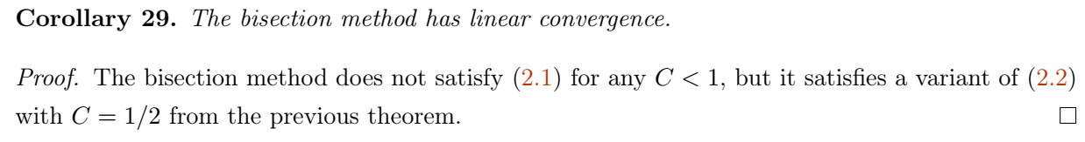
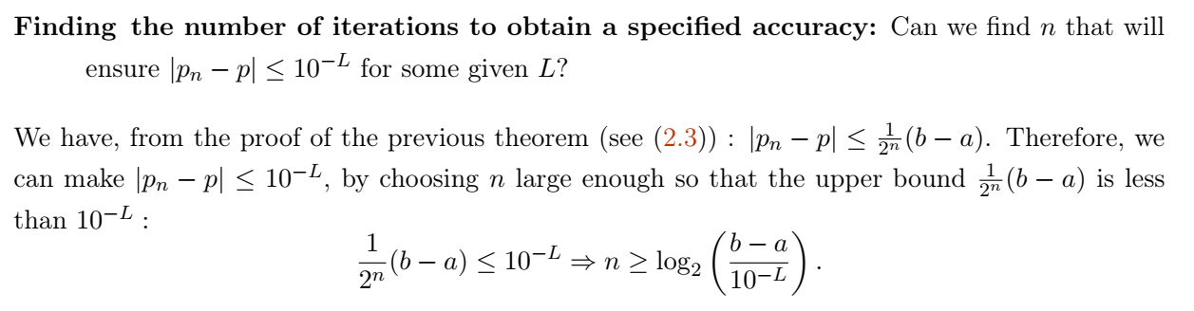

Slide 41
